Slide 1
SportsBetPro
Enhancing Predictive Modeling for Sports Betting
By: Jonah Grossman, Toufiq Hossain, Sean Wei, Naveen Sukumar
Notes:
Jonah

Slide 2
Brief Description
SportsBetPro focuses on leveraging advanced regression and classification models to predict outcomes in NBA betting
Specifically targeting:
Moneyline results: measure of how likely a particular team is going to win
Over/Under: forecasting combined score of both teams
Spread: point differential between two teams
Notes:
Jonah

Slide 3
OUR MISSION & VISION
Problem Statement
Many sports betting enthusiasts struggle with predicting game outcomes
Existing predictive models often lack precision or overlook crucial factors
Our models strive to offer a way to efficiently make calculated betting decisions
Objective
Develop and evaluate regression and classification models capable of predicting moneylines, over/unders, and spread outcomes with high accuracy and positive profit
Aim: achieve accuracy of at least 55% on our betting predictions (Vegas always sets a 10% VIG)
Notes:
Jonah
10% VIG built in a 10% win for the house.
Vegas always get 10% for the loser

Slide 4
Approach/Methodology
Data Collection
EDA
Model Preprocessing
Sourcing publicly available data containing NBA data
Explore relationships between features and distributions of data
Feature Engineering and dimensionality reduction (PCA)
Model Training
Model Evaluation
Impact Analysis
Regression and classification tasks. 80-20 train-validation split
Evaluated and optimized each model based on evaluation metrics
Compared projected outcomes with actual results and quantified expected financial gains
Notes:
Jonah

Slide 5
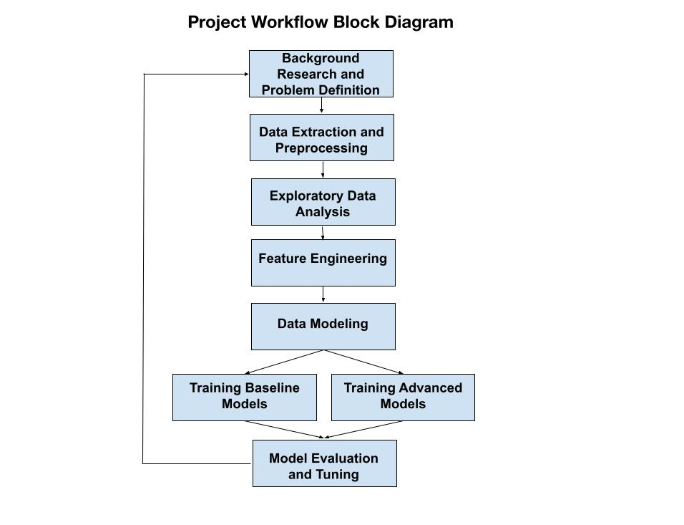
Block Diagram
Notes:
Jonah

Slide 6
Datasets
NBA Player Stats
Contains statistics and performance metrics for players from 1950-2022
Crucial for creating aggregated team stats
Season Based Data Organization
Strategy to split each season into its dataset
Facilitated organization and analysis of data on a season-by-season basis
NBA Odds
Provides NBA betting lines
Essential for modeling moneylines, over/unders, and spreads
Notes:
Jonah

Slide 7
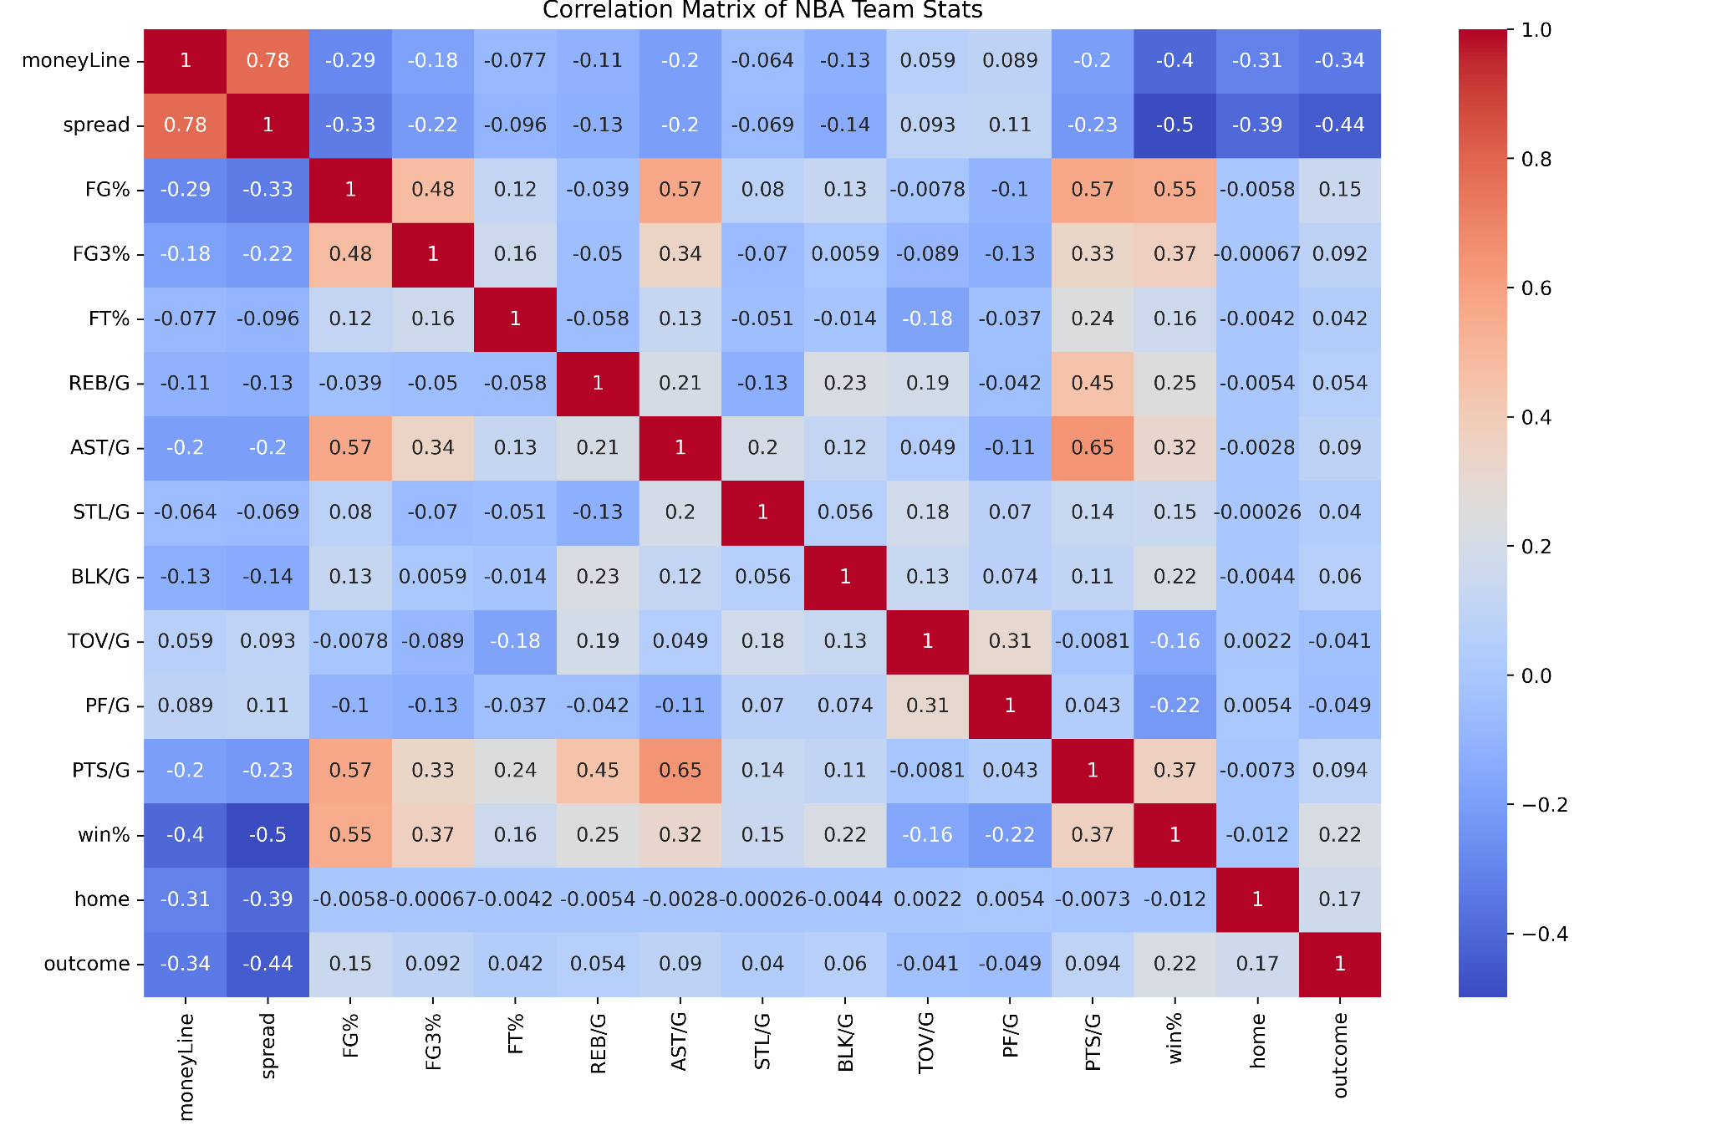
Correlation Heatmap
Notes:
Toufiq
This correlation heatmap serves as a good sanity check for our data. We see that the highest correlations are in line with what we would expect from sports logic. Field goal percentage is strongly positively correlated with winning percentage and points per game. This makes sense because teams are more likely to win if they choose wise shots and consistently make shots from the field.

Slide 8
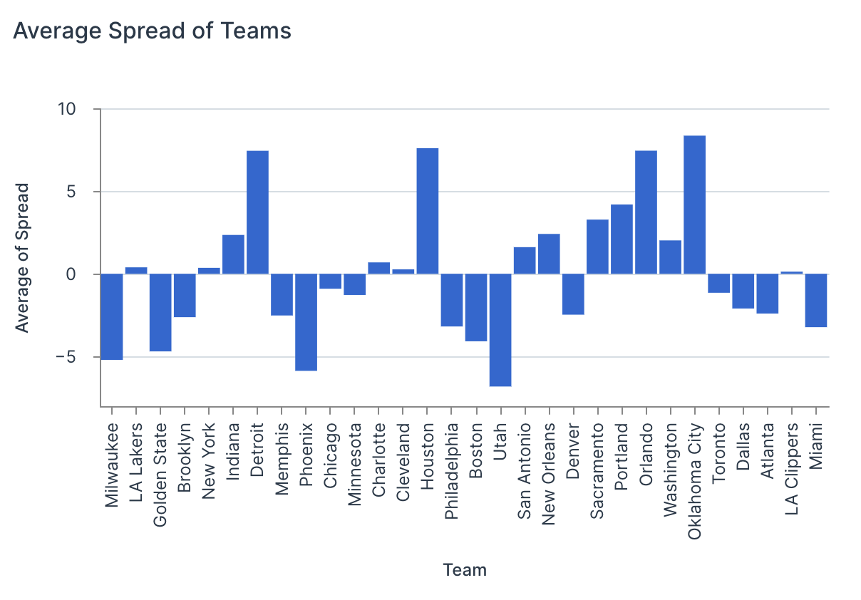
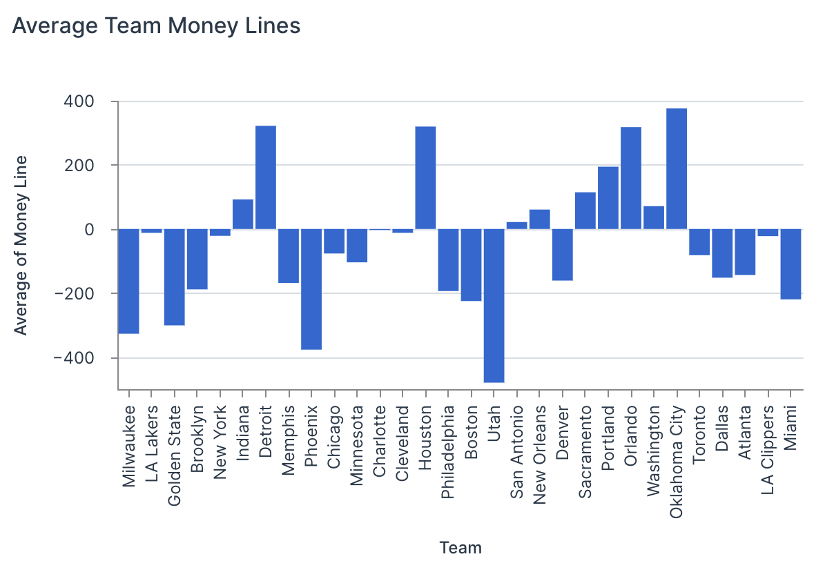
Spreads and Money Lines
Average Spread of Teams
Average Money Lines of Teams
Notes:
Toufiq
One key takeaway we can get from the money line and spread data is that they mirror each other well, highlighting their strong correlation from the heatmap above. These are

Slide 9
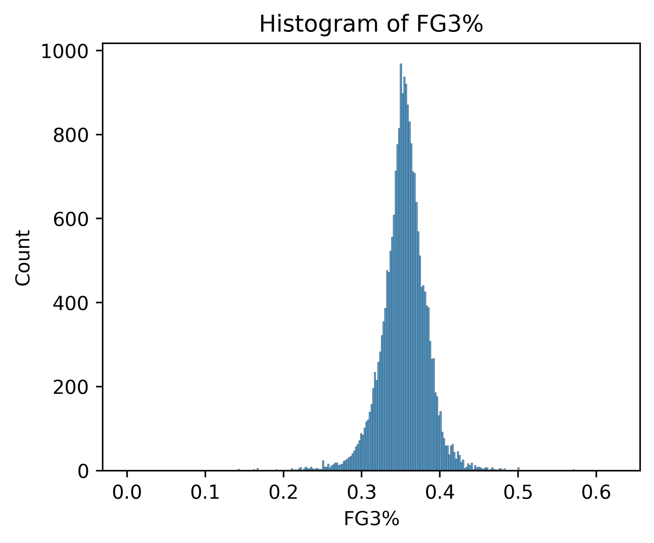
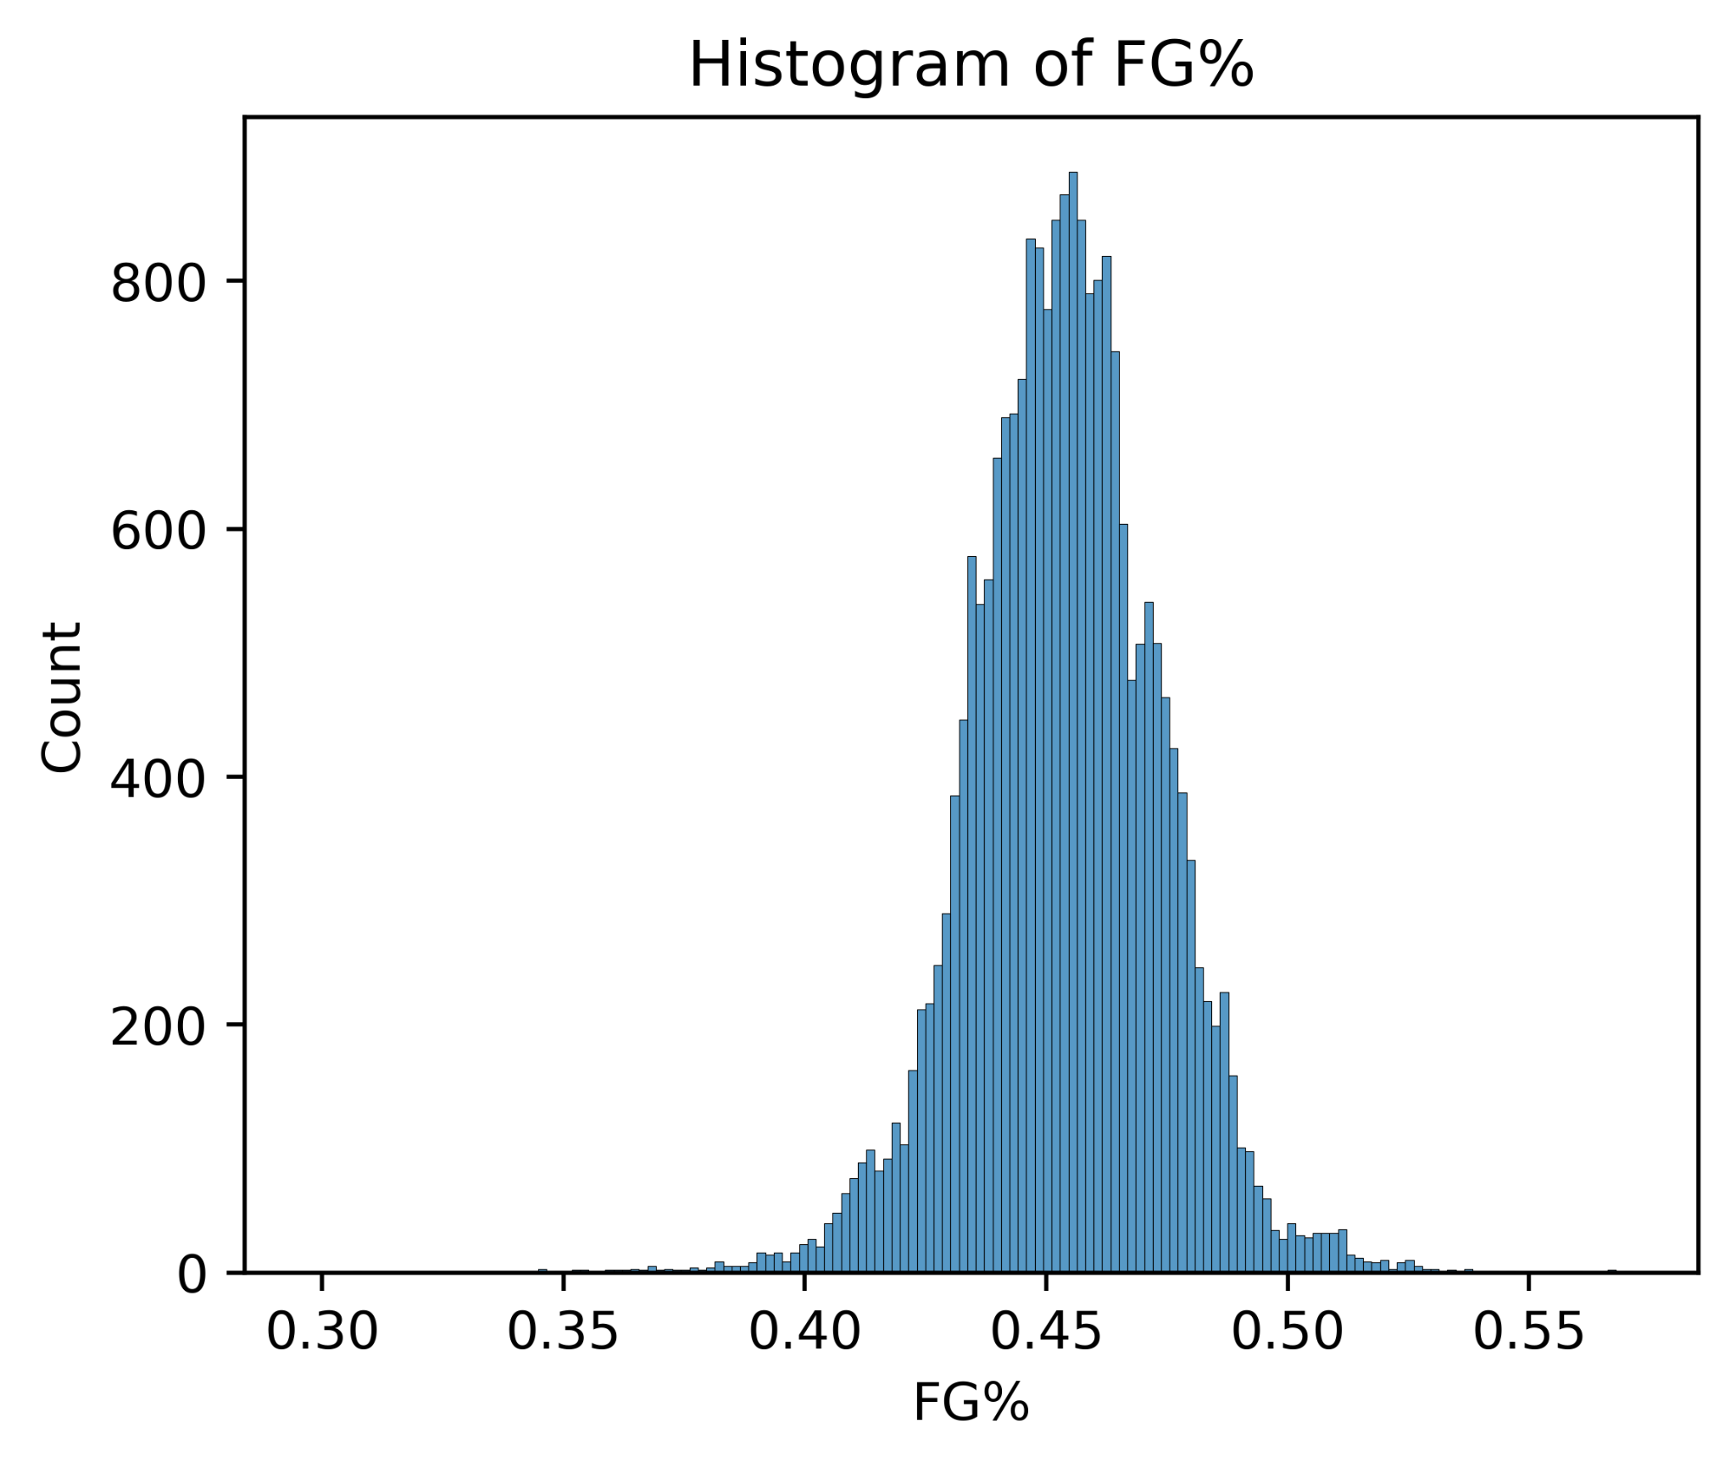
Proportional Metrics
Histogram of 3-Point Field Goal Percentage
Histogram of Overall Field Goal Percentage
Notes:
Toufiq
We included the field goal percentage histograms because of the high kurtosis, showing how important proportional statistics are towards game success. A 5% difference in field goal percentage or 3-point field goal percentage may be the difference between victory and defeat, which is what we often see in many basketball games.

Slide 10
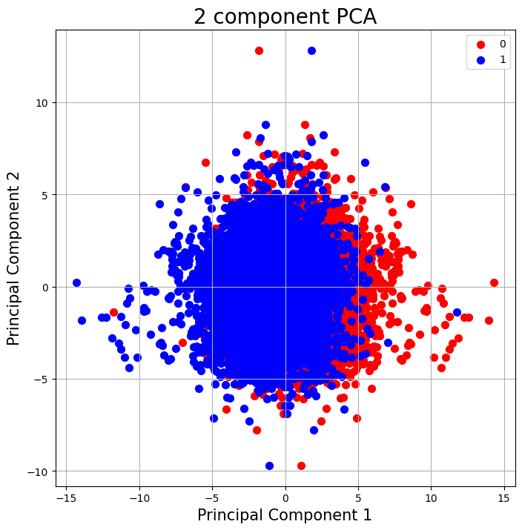
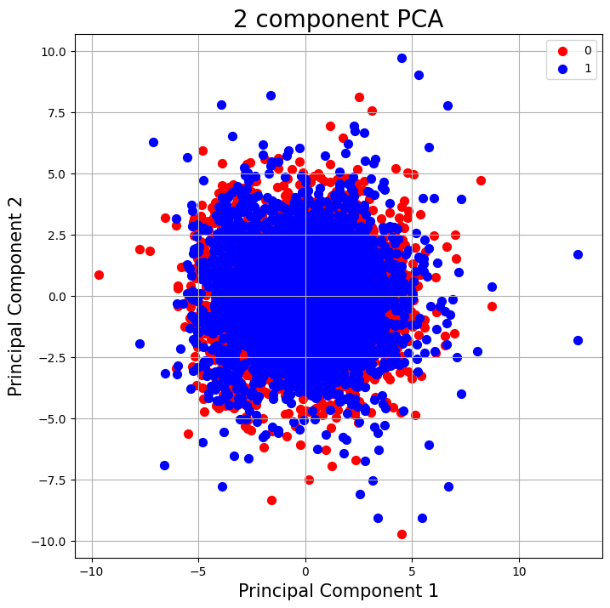
PCA Analysis
Win/Loss
Over/Under
Notes:
Sean

Slide 11
Success & Failure
Proportion of Correct Bets
Models predict more than 55% of its bets
Proportion of Correct Bets
Models predict less than 55% of its bets
Comparison to Vegas
Vegas typically achieve around 80% betting accuracy
Negative Profit
Positive Profit
Negative financial outcomes
Positive financial outcomes
Notes:
Naveen

Slide 12
Evaluation Parameters
Accuracy
Precision
Recall
Measure of exact proportion of bets that were predicted correctly
Measure of how many true positive predicted relative to number of false positives
Measure of how many true negatives predicted relative to the number of false negatives
F1 Score
Root Mean Square Error
Expected Earnings
Composite metric to provide a balanced measure of model performance
Loss metric measuring average distance between predicted and actual values
Expected earnings if we place $100 on every bet our models predict
Notes:
Naveen

Slide 13
Experiments
Win/Loss Classification | Logistic regression, Gaussian Naive Bayes, Random Forest, Support Vector Machine (SVM), AdaBoostClassifier, and a custom Neural Network LSTM and GRU
Over/Under Regression | Linear regression, Random Forest Regressor, Multi-layer Perceptron
Over/Under Classification | Logistic Regression, Gaussian Naive Bayes, Random Forest, and AdaBoost
Spread Regression | Linear Regression, Random Forest Regressor, Multi-layer Perceptron
Notes:
Naveen

Slide 14
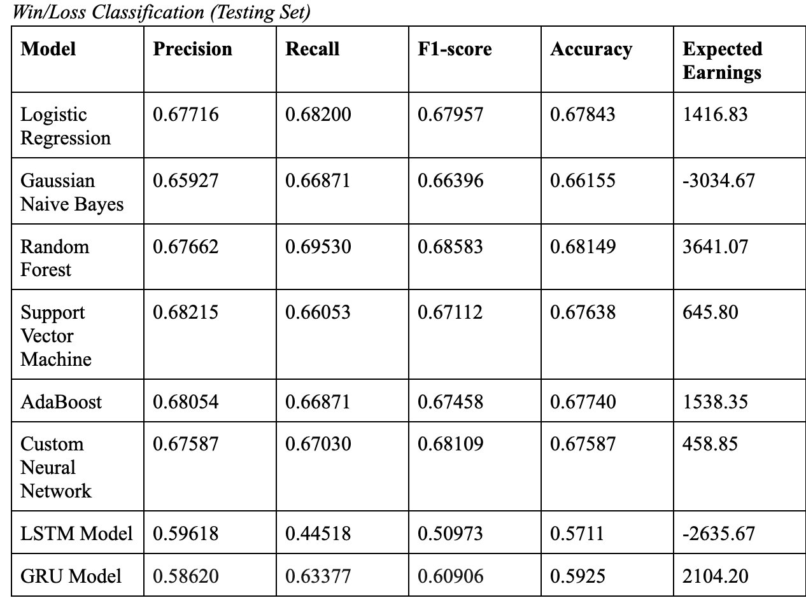
Results
Notes:
Sean

Slide 15
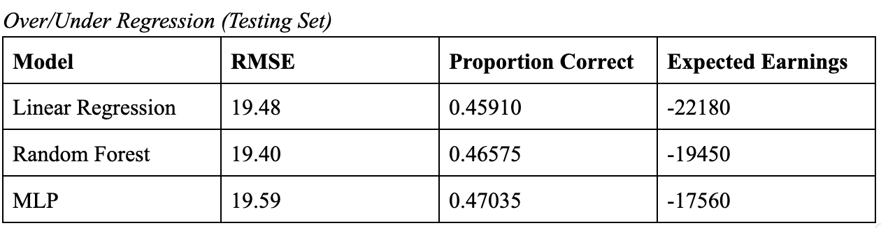
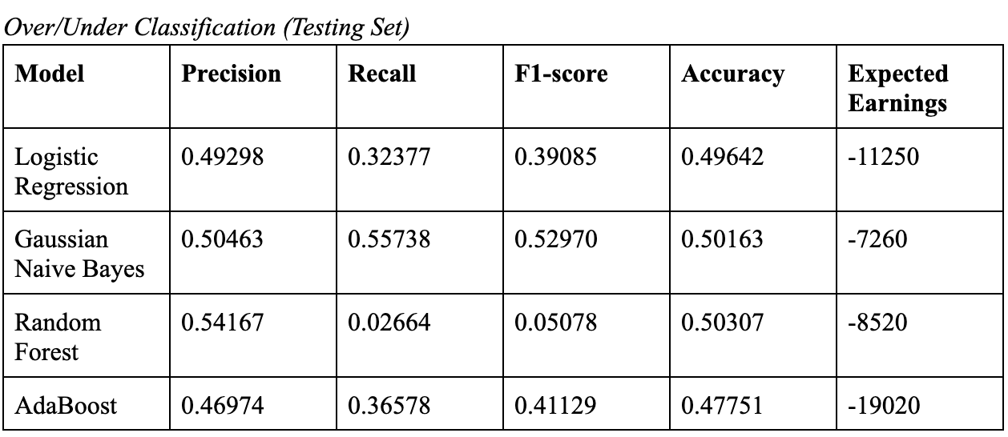
Results Cont.
Notes:
Sean

Slide 16
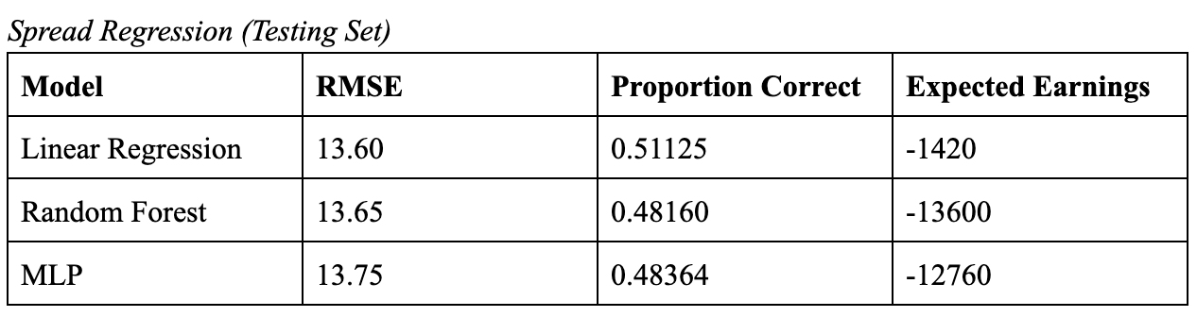
Results Cont
Notes:
Sean

Slide 17
Comparison
Win/Loss Classification performed the best
Data consisted of a lot of in-game baseline statistics (points, rebounds, assists, etc.)
Win/Loss achieved much higher than the baseline
Most models performed >60% on testing set
Regression models did not perform well, about 50% of spread estimates were correct
Notes:
Toufiq
Of all our research questions, the most successful was the win/loss prediction. This was likely due to the structure of our features. Common team level basketball stats such as points per game, rebounds per game, blocks per game, etc. are all very helpful in determining which team is better than the other, but aren’t as helpful when trying to predict how many points are scored in total (over/under), or the final score differential (spread). The combination of these features with the seamless fit into a binary classification task framework makes the win/loss prediction task perform the best. Our metrics as shown in the figures above support this assumption, with our F1 score, precision, recall, and accuracy all consistently being very high all across the entire board on our test set. They perform significantly higher than the classification task for over-unders, which don’t perform much higher than the baseline with expected 50%. With our regression models we see that about 50% of the spreads from the models were within the actual results of the game, but the expected earnings from the predictions were all negative, which isn’t the best indicator for a model in this context.
Overall, we wanted a predictive model that performs better than the 50% accuracy rate that we would get with no sports knowledge, and the regression models nor the over-under classification models provided that. The win/loss classification models provided us with the best results for this case, giving us the most confidence in those models.

Slide 18
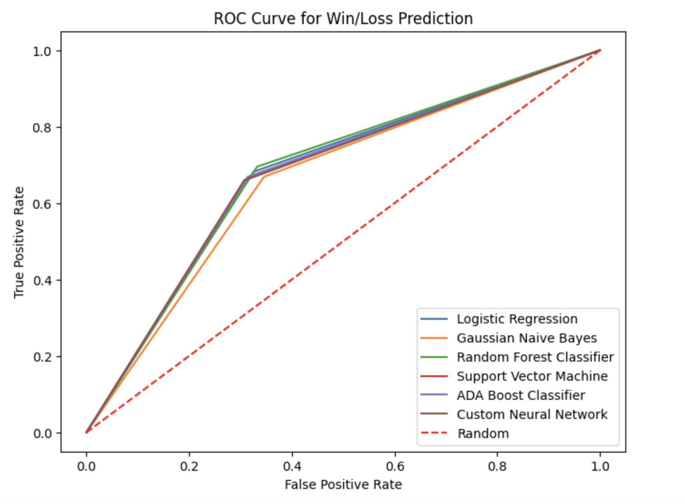
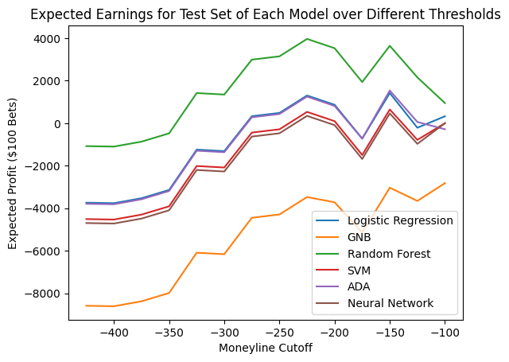
Discussion
Win/Loss Prediction:
Best performing models by far
Notes:
Sean

Slide 19
Discussion
Over/Under Regression:
Lowest proportion of correct bets
If you go against our predictions you make money ($7280, $4420, $2160)
Bad models -> useful results
Over/Under Classification:
Poor model performance - all models essentially guessing
Two main contributors:
Our set of features
How sportsbooks design this problem
Notes:
Sean

Slide 20
Discussion
Spread Regression:
Also hitting around 50% of bets
Likely suffering from the same circumstances as over/under
Only losing money because Vegas takes a cut:
Removing the 10% cut gives us $7800 expected earnings
Notes:
Sean

Slide 21
Constraints
Limited Timeline
Absence of Individual Player Data
Sportsbook Lines
Notes:
Sean

Slide 22
Limitation
Use of Aggregated Team Data
Unpredictability of Extraneous Factors
Temporal Variability
Specific Matchup Dynamics
Notes:
Jonah

Slide 23
Future Work
Incorporating Most Recent NBA Data
Enhancing Model Tuning
Incorporating Dynamic Factors
Advanced Statistical Techniques
More Specialized Features
Evaluation of Profitability
Notes:
Naveen

Slide 24
Human Context and Ethics
Addressing Bias & Promoting Fairness
Influence of Market Size
Small market teams face disadvantages, while larger market teams' advantages may introduce biases in predictions, requiring recognition and correction for fairness.
Ensuring fairness in predictive modeling demands rigorous methods, diverse data, and ongoing refinement to address biases, ensuring equitable sports betting predictions.
Notes:
Small market teams face inherent disadvantages, impacting their ability to compete, while larger market teams enjoy advantages that may introduce biases in sports betting predictions, necessitating recognition and correction for fair treatment.
Promoting fairness in predictive modeling requires rigorous methodologies, incorporating diverse data sources and ongoing refinement to identify and address biases, ensuring equitable treatment in sports betting predictions.
In addition, we want to be able

